Slide 1
Airport Safety and Quality Review Board
ASQRB
June 28th, 2023
Reviewing May and 2023 YTD Performance
Notes:
What does ASQRB stand for?

Slide 2
Agenda
Special Content
Compliance Monitoring Program
Safety Moment
Safety Accolades
General Updates
Daily Inspections
QCI inspections - Preview
QA Inspections – Preview
Training Compliance Monitoring – Future Addition
Safety Performance
Safety and Quality Updates
Corporate Goals:
Goal #1- Aircraft Damage
Goal #2 – LTI + OSH Data
Top 3 Targets
Engine Hazards
People Safety and Top 3
Significant Safety File Review
Safety Communications
Safety Program Updates
Online Safety Board updates
Safety Round Table
Station and Regional Safety engagement discussion round table

Slide 3
Safety Moment
Engine Safety
On Friday, June 23, 2023, a ground handling agent working at the San Antonio International Airport was killed after being ingested into a plane engine. The plane was taxiing to its arrival gate when the accident took place. This is a sobering reminder that the ramp is full of many hazards, and it is important that all safety precautions are taken during every step of every single arrival and departure. Always remember to wait before approaching the engines until it is safe to do so.
The spool down time for the B737 is approximately 30 seconds. Other indications of a running, or soon to be running, engine include: - Heat distortion from the exhaust area
- Flashing anti-collision beacons
- Spinning engine compressor blades
- Air start unit in position
Safety barriers (SOPs) are in place to prevent engine ingestion; please be reminded and take stock in why they MUST be followed every time you approach a live aircraft:
Once the aircraft has stopped, walk parallel to the fuselage until even with the nose gear and turn to approach the aircraft at a 90⁰ angle. For DH8 operations, chock the nose gear once the propellers are feathered.
Avoid engine hazard areas (these areas are indicated via markings on the fuselage and engine cowlings)
Await the marshaller or VDGS operator’s “All Clear” signal before approaching the main gear.
Notes:
This is the second death from engine ingestion this year

Slide 4
Safety Accolades
Tom Rae – L&D - Sincere thanks for your team spirit and flexibility to support Team YLW for nearly two weeks. Your continual focus on the right things at the right time helps Team Members be safe and successful in their roles.
Ivan Li – YYJ - My most sincere expressions of respect for your teamwork and support where attention to detail, risk management and prevention make for a safer operation.
Mathew Lee – YXS - Matt Lee went above and beyond in his efforts to keep this afternoon's late flight on time as possible while keeping safety standards up. | A big thank you to my team here in YXS. Everyone making sure our operations run smoothly.
Notes:
Accolades are only coming from Work Tango at this point, please remember to ensure that the safety category is used to identify safety related items.

Slide 5
General Updates
The Safety Team is working on a number Safety Program and Policy Updates:
Safety Reporting Policy.
The reporting policy has been updated and will be uploaded to the vortex portal on Friday June 30th, with a bulletin being released to leaders on the same day.
Safety Risk Hazard Policies.
The reporting policy has been updated and will be uploaded to the vortex portal on Friday June 30^{th,} with a bulletin being released to leaders on the same day.
Training Management Plan 1.3.5 requirements.
The work orders for the training file review have been in place since June 1st, current completion stats will be reviewed later in the presentation.
Safety Dashboard Portal.
over the past few weeks, the back-end work order system has been audited, with changes made to categories to allow us to implement the new tracking categories discussed in last month’s ASQRB. Currently the OH&S inspection and meeting minutes have been updated and the operations team can officially run reports based off induvial stations. The audit program review is currently underway with the changes being completed over the next few weeks with an update being provided at next month’s meeting.
Peak Season Readiness (Summer)
The Peak Season Readiness program manual has been prepared and will be reviewed prior to release with the intention of release set for in early July.
Notes:
The peak season manual is the first time putting this program together, we understand we are already heading into July however we wanted to make sure that information released is accurate and thoroughly reviewed, this manual will include information from all the past bulletins regarding working safely and working in extreme heat

Slide 6
Airport Safety and Quality Review Board
Special Content Questions?

Slide 7
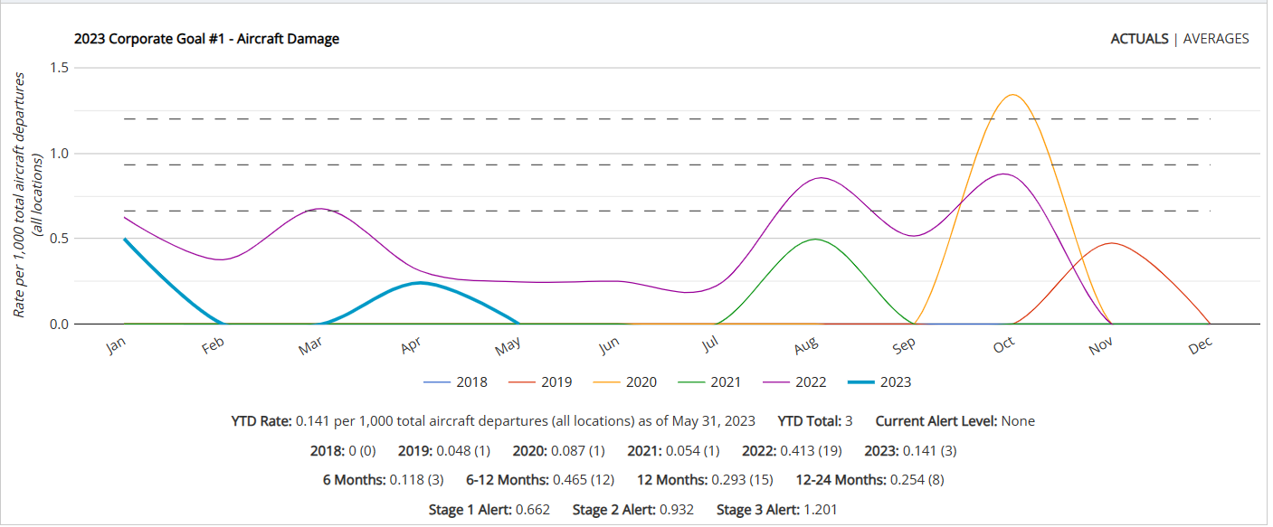
Goal #1 – Aircraft Damage
2023 Target – 0.392
2023 Actual – 0.141
Notes:
The 2023 Corporate Safety Goal for Aircraft Damage is 0.392 rate per thousand. This is set at a 5% reduction (improvement) from 2022 rate of 0.413

Slide 8
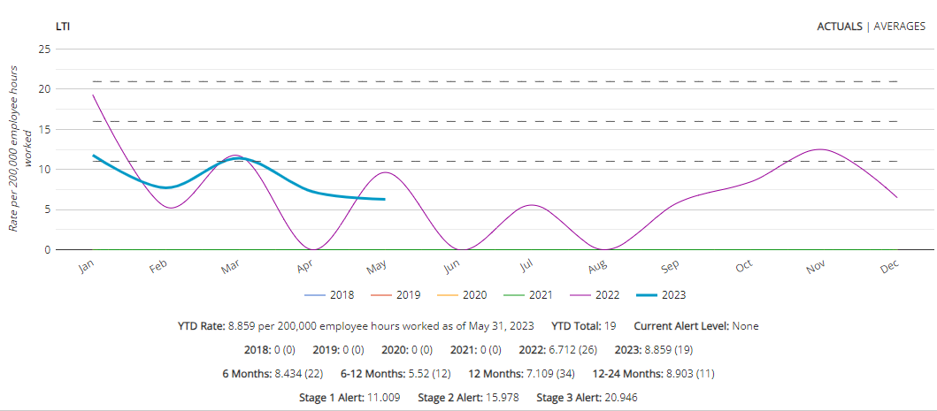
Goal #2 – LTI
2023 Target – 6.712
2023 Actual – 9.601
Notes:
19 LTI YTD

Slide 9
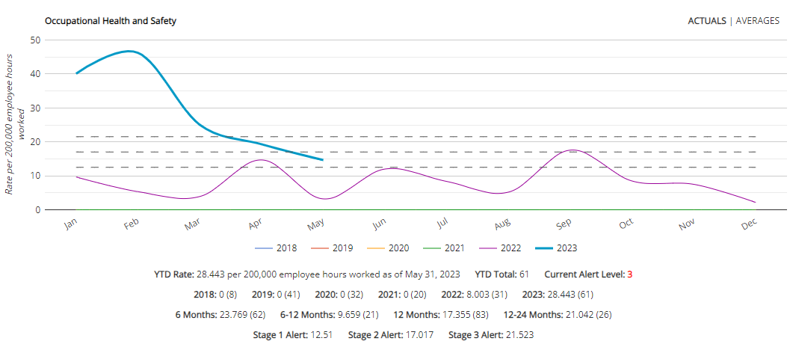
Occupational Health and Safety
Notes:
Numbers continue to move in a downward trend consistent with weather changes.

Slide 10
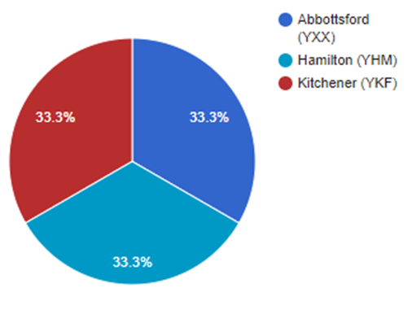
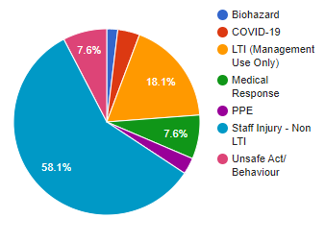
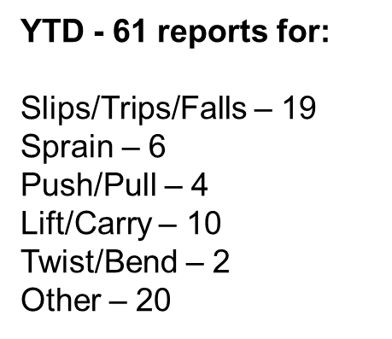
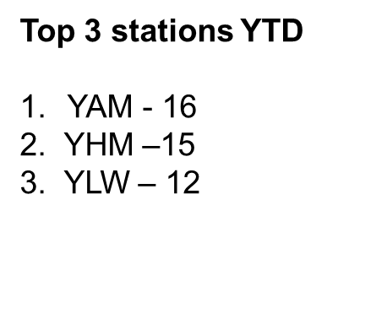
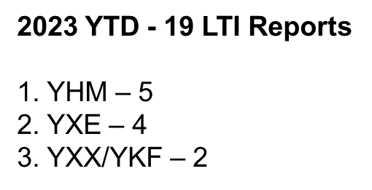
Goal #2 – OSH Data
May - 3 LTI Reports
Notes:
105 OH&S Staff Related Reports YTD
12 OH&S Staff Related reports filed in May
•Staff Injuries Non LTI events – 7 events
•4 x lift & carry
•1 x Other (Twisted back- reinjury)
•1 x push & pull
•1 x Sprain
3 LTI events for May 1 x Abbottsford & 1 x Hamilton & 1 Kitchener
12 Committee meetings planed – 8 of 16 completed – 50%
Safety Inspections - BTW – 18 of 19 completed - 94%
ATW – 14 of 21 completed - 66%
FBO – 4 of 4 completed -100%
SHOP – 4 of 4 completed –100%
Committee Meetings duel signature block at the bottom of the form

Slide 11
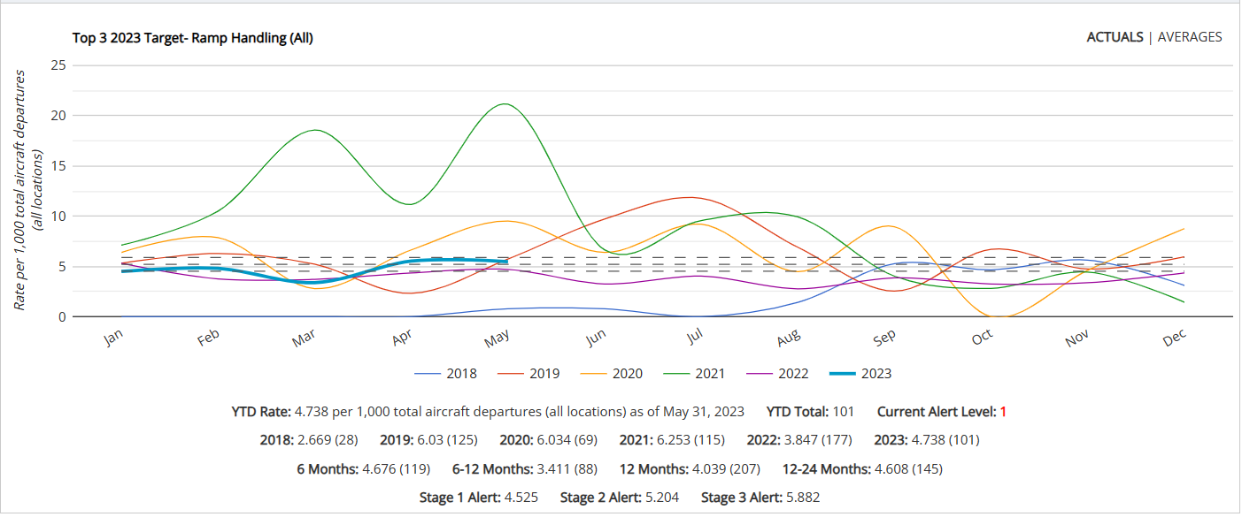
Target #1 – Ramp Handling
2023 Target – 3.847
2023 Actual – 4.738 - Stage 1 Alert

Slide 12
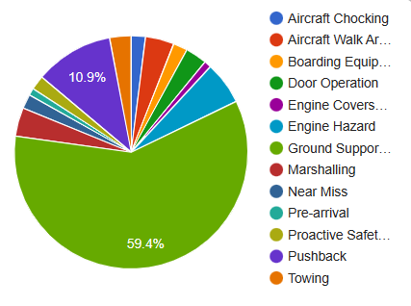
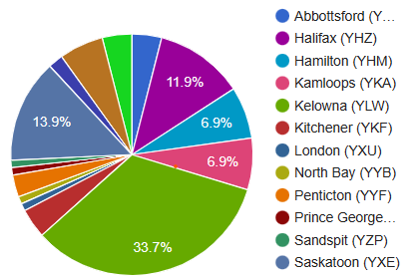
Target #1 – Ramp Handling
YTD –Jan 1 –, April 30th, 2023
YTD- 101 Incidents
Top 3 by descriptor category:
Ground Support Equipment Operation- 60
GSE Maneuvering – 17
Collision with Airport Infrastructure- 12
Collision GSE to GSE- 10
Push Back –11
Engine Hazard - 6
YLW – 34
YXE - 14
YHZ – 12

Slide 13
Ramp Handling
GWG- Team Members:
Kris van der Staay - RM
Ben Schram - YSB
Malachy O’Doherty - YHM
Tom Rae - Training
Chris Teixeira - YXU Shop
Duncan Lundy - YXX
Maria Miller – YHZ
Nathan St Anne - YLW
EA Safety Team
***NEW*** - GSE Operation Working Group Concept
A working group will be formed of volunteers across the organization – To look at ways of reducing our GSE Operation safety incidents
Volunteers (depending on station structure)- would include SM's, Operations Managers, RC's, Trainers. OSH Reps, Training Team and the GSE Team.
Graham Lindsay will be Leading the working group.
The Working group will be an ongoing program for 2023. This would include multiple sessions.
The working group progress will be reviewed at the ASQRB.
Timeline:
May – Volunteer requests will go out- Completed
June - Working Group Team members will be identified- Completed
June - The Safety Team will prepare all historical data and set up the format for the working group.- On track
June - Session #1 Scheduled - On Track – July 18th
Session #1
Review of Historical data to determine (statistically) areas of safety incident focus – Example – Contact with Airport Infrastructure.
Brain storming session to look at areas of opportunity.
Notes:
-We will be leaving the volunteer process open for the time being, if anyone else would like to join please feel free to reach out to the safety team.

Slide 14
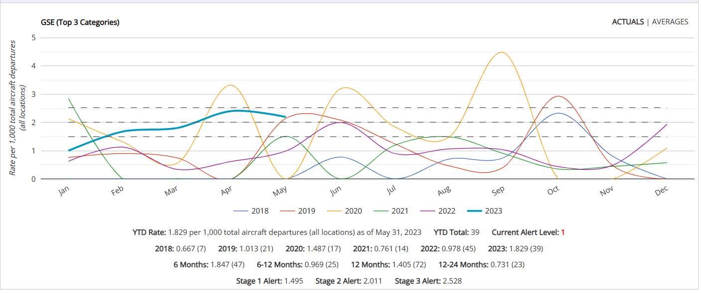
GSE – Top 3 Categories (Sample)

Slide 15
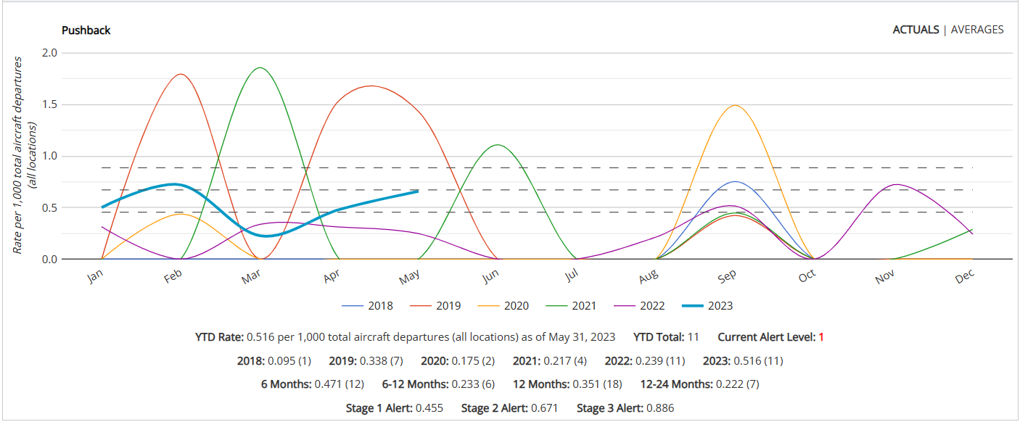
Pushback (Sample)

Slide 16
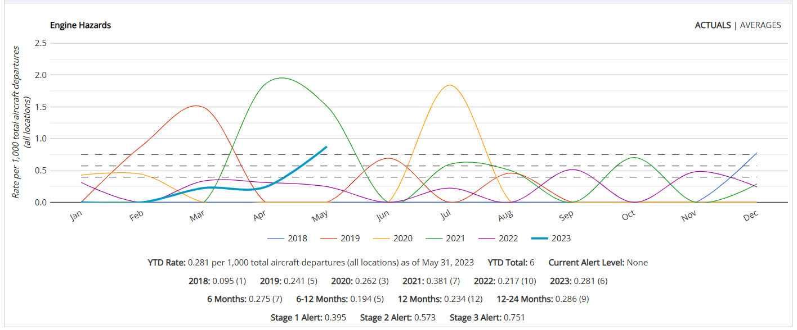
Engine Hazards
2023 Actual – 0.281
Notes:
YXE- 3
YAM- 1
YLW-1
YYT- 1

Slide 17
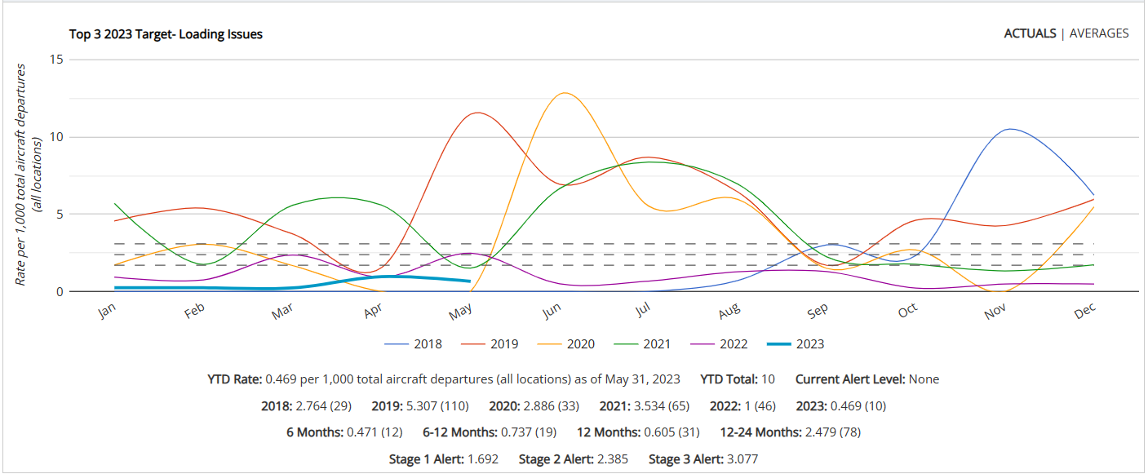
Target #2 – Loading Incidents
2023 Target – 1.0
2023 Actual – 0.469

Slide 18
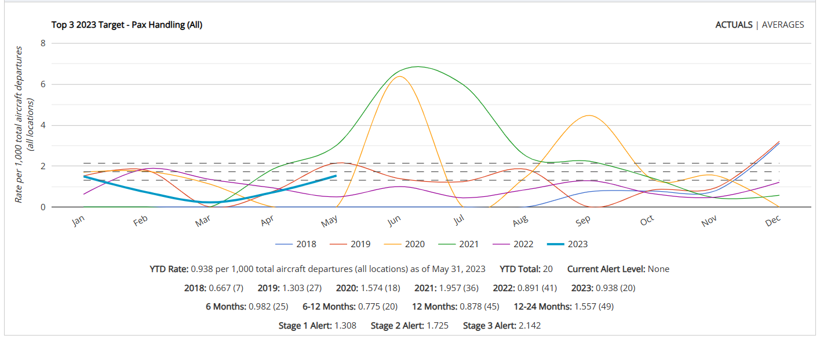
Target #3 – Pax Handling
2023 Target – 0.891
2023 Actual – 0.938

Slide 19
Airports Safety and Quality Review Board
Corporate Goal and Targets Questions?

Slide 20
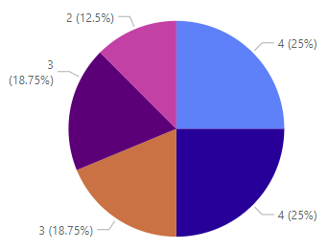
BTW QC Audit Activities
Major Findings
- No major findings
Trends YTD

Slide 21
Station QA Audit Activities
Station QA Audit Results
Major Findings
Date | Station | Internal/ Airline | Findings | Major Findings | Findings-BTW | Findings- ATW | Observations
May 2nd | YYF | WestJet | 0 | 0 | 0 | 0 | 3
No major findings
Scheduled Audits
Trends
Date ​ | Station​ | Internal/ Airline​
​
​ | ​ | ​
No Trending Items

Slide 22
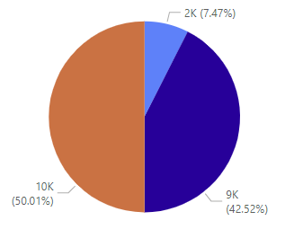
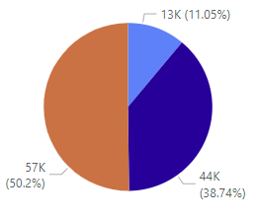
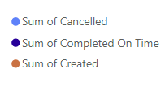
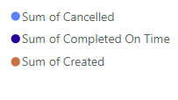
Daily Inspections
April Year To Date
Top 3 Stations
Station | Completed on time %
Kamloops (YKA) | 100%
London (YXU) | 100%
St. Johns (YYT) | 100%
West Kootenay (YCG) | 100%
Penticton (YYF) | 100%
North Bay (YYB) | 98%
Kitchener (YKF) | 98%
Prince George (YXS) | 94%
Halifax (YHZ) | 94%
Bottom 3 Stations
Station | Completed on time %
Fort Nelson (YYE) | 40%
Kelowna (YLW) | 59%
Abbotsford (YXX) | 75%
Notes:
May – 85% completion rate, overall completion rate up 7% from April
YTD – 75% completion rate
fifth month in a row Kamloops is at a 100% completion rate
Within two months Halifax has gone from the bottom 3 list to top stations with a 94%
Kelowna is continuing to improve however we will continue to work with the station, a review of corrective actions will be done with potential updates to those actions
We have had discussions with Fort Nelson and will be monitoring the actions put in place
Currently June’s overall completion rate is sitting at 87%
May has been the first month YTD with 5 stations sitting at 100%
YXX is on the bottom 3 list with 75%, this emphasis the improvement across the board with daily inspection completion rates. ( during the first ASQRB of the year the bottom stations had a completion rate of 1%, 5% and 12%)

Slide 23
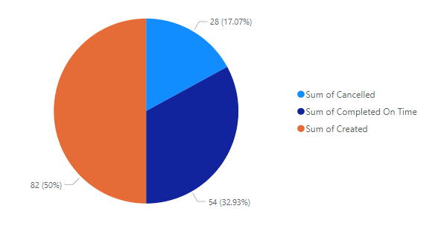
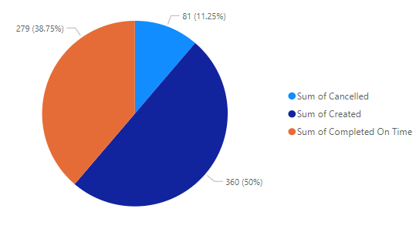
PCI Compliance
May Year To Date
Bottom 3 Stations
Station | Completed on time %
Sudbury (YSB) | 0%
Kelowna (YLW) | 40%
St. John’s (YYT) | 50%
Top 3 Stations
Station | Completed on time %
Halifax (YHZ) | 100%
London (YXU) | 100%
Sault Ste. Marie (YAM) | 100%
Notes:
Review was done for all stations to ensure required PCI work orders have been set up – some stations were not 100% correct. This has been fixed with Christine’s help.
Some WestJet / Swoop stations were using the word document instead of the duplicated checklist within the work order system. All stations will be set up for next month with the correct checklist which should be completed going forward as opposed to the word document.

Slide 24
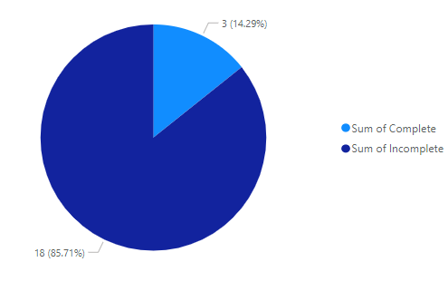
Safety and Quality Updates
Notes:
Training File review
Currently only three stations have completed the June’ training file review.
The Safety Team work order for the completion review is currently set up and will be live next Monday. On June 30th the current work orders that are incomplete will be cancelled which means any incomplete work orders will not be able to be adjusted. If any one is concerned with how long this should take please feel free to use the work order to track the completion, this is something we can discuss next month.
You may notice that this only totals 21 stations, we have paused a single work order to do leadership changes to allow the station a chance to do a review when the local leader has returned.

Slide 25
Safety Action Log
Category | Status | Identified/Trend | Factors | CAP/Mitigation
OSH- Body Mechanics Program(s) | In Progress | Identified need for BTW body mechanics program and review of existing programs | There is currently ATW online body mechanics training – But not for BTW. The goal would be to implement/ review programs to help reduce injuries. | Exploration Phase
OSH- Peak Season Readiness Programs | In Progress | Identified need for Peak Season Readiness program | Working in various weather conditions creates a several OSH Hazards - Slips/ trips and falls, extreme cold conditions, Extreme Heat etc | Final review to be completed by End of June Review with Lonel's Team. Delivery plans to be determined- Release V1 in July
Ramp Handling- GSE Operation | In Progress | GSE Operation represents +50% of all Ramp Handling incidents | GSE to GSE contact/ GSE to facility contact/ GSE to AC contact/ GSE maneuvering/ GSE towing | GSE Operation - Working Group- established First session planned for July
Ramp Handling Pushback | In Progress | Recent Incidents have identified areas for improvement | Tow bar connection / disconnection Pushback readiness/ hazard awareness and troubleshooting pushback issues. Headset Communications Wing Walker Requirements. | Pushback Safety Read N Sign issued May 18th: System wide plan to ensure all pushback tractors have a pelican case and functional headset per unit. Monitoring Phase.- Through ongoing data analysis
Engine Hazards | In Progress | Recent Incidents have identified areas for improvement | Engine Spool Down Prop feathering Anti- collision light All Clear signal Engine start up | Expand Descriptor set to identify multiple scenarios. Trending station Corrective Actions System wide awareness/ safety Promotion

Slide 26
Round Table

